Slide 1
Story-Based Burn Down
Case Study and Discussion

Slide 2
Scrum Team Pains
Scrum team (at least our team) pains:
Obsesses over sprint planning, especially the task estimates
Long, boring meetings
Big estimation gap between different individuals
Hard to measure true feature completion using burn down chart
# of hours spent cannot represent # of feature completed
Team still concerned about the commitment even if the burn down looks good
Hard to measure the true velocity
If we measure velocity by actual hours the team spent, possibly the velocity will be pretty high even if nothing is done
Hours look more like “capacity” rather than velocity

Slide 3
Situation in our Sprint # 1
We spent 6 hours in our 2-week sprint’s planning meeting
The burn down chart looked good but the feature completion was bad
We used actual hours to measure velocity, but by the end of sprint # 1 we were not confident to use that velocity to make the commitment for the next sprint
Iteration Burn Down Chart
Features Delivered
300
270
240
210
180
150
120
90
60
30
0
297
11
10
9
8
7
6
5
4
3
2
1
0
279.5
10 10 10 10 10
249.5
9 9 9
196.5
180 180
8 8
7 7
Hours
Hours
125.5
105 105
81.5
67.2
Monday Tuesday WednesdayThursday Friday Saturday Sunday Monday Tuesday WednesdayThursday Friday
Week 1 Week 2
Date
Monday Tuesday WednesdayThursday Friday Saturday Sunday Monday Tuesday Wednesday Thursday Friday
Week1 Week 2
Date

Slide 4
Key Problems we want to resolve
Seems all the problems are related to “hours”:
Hard to use hours to size the stories/tasks
Hard to associate the time-based burn down with the feature completion
– Using actual hours to measure true velocity is not the best solution – how many hours the team can burn has no direct relationship between the commitment which is the final delivery

Slide 5
Our solution for resolving the issues
Story Points is a better choice for the estimates
Published research shows that humans are terrible at estimating anything in hours ¹
The tasks which one team/individual can finish in 10 hours may cost 100 hours for another team/individual
Story Points is the absolute value for the size of the Product Backlog Items (PBIs)
Task-based burn down could represent true completion
No direct relationship between time spent and feature completion
Task-based burn down should be more meaningful
Key dependency is a clear “definition of done” for the tasks
Use story points to measure the velocity
Velocity is how many story points a team can deliver in one sprint, not how many hours a team can burn
We can use “Story Points finished/sprint” as the formula when calculating the velocity
[1] - See the references

Slide 6
Improvement Plan for Sprint # 2
Action | Description
1. Improve the Task Break Down | 1) Decompose the final deliverables into small pieces, create one task for each small piece
 | 1) Define "done" for each task - ensure the completion of each task means the delivery of one potential shippable product
1. Use Story Points for estimation | 1) Select one “ template story” as the standard criteria
 | 1) Get the story points for each task based on the comparison with the template story, but still estimate how many ideal hours we need to finish that task
1. Use the Task-based Burn Down for tracking | 1) Start to use Task-based Burn Down (still use Time-based burn down at the same time)
 | 1) Record the actual hours we spent to finish the tasks
1. Measure velocity using story points finished/sprint | 1) After we get stable team velocity, then stop doing estimates using hours, stop using actual hours to measure velocity

Slide 7
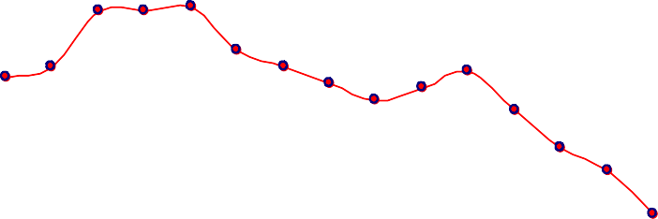
Our practice in Sprint # 2
Spent 4 hours for the sprint planning
Improved task break down and definition of “done”
Created template story and estimated all the tasks using Story Points
Established task-based burn down chart
time-based burn down chart
task-based burn down chart
200
180
160
140
120
100
80
60
40
20
0
50
45
40
35
30
25
20
15
10
5
0
184 183
163 165.5
144.5
123.5
114
40 40
41
30
33
30
29
Hours
28
27
24
26
22
Hours
101
15
83.2
11
63.7 _{60.9}
3
^{27.4} 20.7 19.7
4.5
MondayTuesdaWyednesdTahyursdayFridayMondayTuesdaWyednesdTahyursdayFridayMondayTuesdaWyednesdTahyursdayFriday
Week1
Week2
Week1 Week2

Slide 8
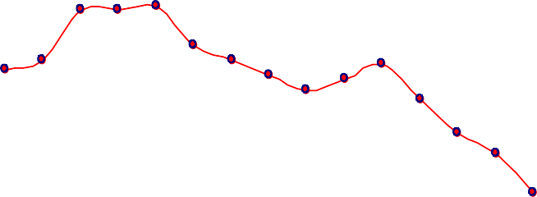
Benefit of using new approach
 In general, the task-based burn down matches the feature completion
– Which means the chart can represent the real velocity
task-based burn down chart
spring # 2 feature completion
50
45
40
35
30
25
20
15
10
5
0
12 12 12
11
10
9
8
7
6
5
4
3
2
1
0
40 40
41
11
10
30
33
30
29
Hours
28
27
24
26
Remaining Features
8 8
22
7
15
11
6 6
5
3
4
2 2
Week1
Week2
1
0
MondayTuesdaWyednesdTahyursdayFridayMondayTuesdaWyednesdTahyursdayFridayMondayTuesdaWyednesdaTyhursdayFriday
Week 1 Week 2

Slide 9
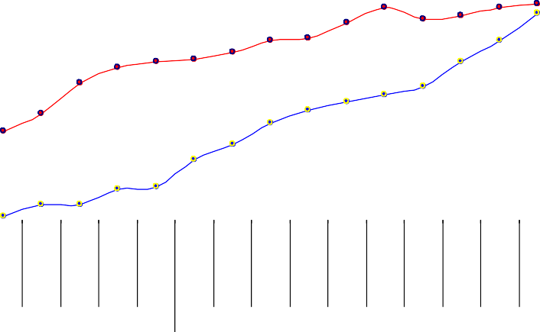
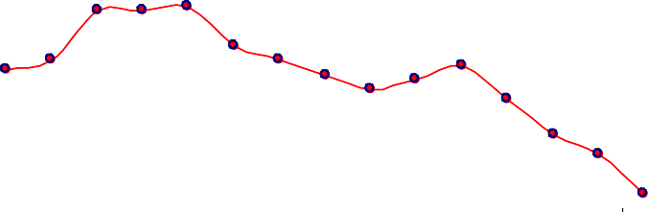
New challenges

Task-based burn down is still not good enough to represent feature completion
Tasks are too detailed - the # of tasks kept increasing, it’s hard (and not necessary) to identify all the related tasks to complete one story in sprint planning meeting
Too many dependencies between different tasks and also we had lots of generic tasks like document writing/regression testing
task-based burn down chart
task-based Iteration Progress
50
45
40
35
30
25
20
15
10
5
0
80
70
70
70
71
40 40 41
65
66
67
68
33
60
53
55
59 60
59
Hours
28
30
30
27
29
50
45
50
52
52
24
26
22
Hours
40
39
41
44
15
30
29
35
32
36
11
20
20
25
3
10 10 11
5 5
0
1
Week1
Week2
Monday
Tuesday
Wednesday
Thursday
Friday
Monday
Tuesday
Wednesday
Thursday
Friday
Monday
Tuesday
Wednesday
Thursday
Friday
Week 1
Week 2

Slide 10
Our solution for the new challenges
Use story-based burn down instead of task-based burn down
Tasks are so detailed that sometimes we can not say they are potential shippable deliverables
But obviously one story is a potential shippable deliverable
Story-based burn down and task-based burn down are essentially the same

Slide 11
Next step
Action | Description
Continue to improve the Task Break Down | 1. Scale down the size of each story, use “stories” to represent small features, e.g., small enough for one developer to finish in 2-3 days
 | 1. Need a clear definition of done for each story – usually use passing FT/ UAT without Major and above defects as the exit criteria
Estimate the size of each story | Use story points to estimate the size of each story, but DON’T do estimate for all the tasks
Use the story-based Burn Down for tracking | 1. Still use 2 burn down charts at the same time: story-based burn down and effort-based burn down.
 | Only deduct the estimated story points when the corresponding stories are Completely Finished – meet the definition of done
 | 1. Record the actual hours only for reference, and calculate how many stories (or story points) team can finish in one sprint as the true velocity

Slide 12
One sample sprint - sprint backlog (mock up)
Total:
120
400
Story | Est. Points | Task | Task Act Hours | Story Act Hours | Done
Story # 1 | 8 | Requirement review + Test Case Development | 1 | 11 | √
 |  | Front-end code + Selenium Test | 3
 |  | UT + Back-end code | 4
 |  | Integration + Integration Test | 3
Story # 2 | 5 | Requirement review + Test Case Development | 1 | 8 | √
 |  | Front-end code + Selenium Test | 3
 |  | UT + Back-end code | 1
 |  | Integration + Integration Test | 3
Story # 3 | 13 | Requirement review + Test Case Development | 2 | 18 | √
 |  | Front-end code + Selenium Test | 0
 |  | UT + Back-end code | 8
 |  | Integration + Integration Test | 8
 |  | ……
Story # 15 | 5 | Requirement review + Test Case Development | 1 | 7 | √
 |  | Front-end code + Selenium Test | 2
 |  | UT + Back-end code | 2
 |  | Integration + Integration Test | 2

Slide 13
One possible sample sprint - Metrics
Date |  | Total Stories | Rem. Est. Stories Points |  | Burned Points | Rem. Points | Actual Hours Act Hr/D |  | Points/D
Week 1 | Monday | 15 | 15 | 105 | 0 | 105 | 8 | 2.00 | 0.00
 | Tuesday | 15 | 15 | 105 | 0 | 105 | 20.8 | 2.60 | 0.00
 | Wednesday | 15 | 14 | 110 | 13 | 97 | 34 | 2.83 | 4.33
 | Thursday | 15 | 12 | 110 | 31 | 79 | 48 | 3.00 | 7.75
 | Friday | 15 | 11 | 113 | 36 | 77 | 61.6 | 3.08 | 7.20
Week 2 | Monday | 15 | 8 | 115 | 46 | 69 | 82 | 3.42 | 7.67
 | Tuesday | 15 | 6 | 118 | 57 | 61 | 101.6 | 3.63 | 8.14
 | Wednesday | 15 | 4 | 115 | 64 | 51 | 118.4 | 3.70 | 8.00
 | Thursday | 15 | 2 | 120 | 85 | 35 | 136.8 | 3.80 | 9.44
 | Friday | 15 | 0 | 120 | 120 | 0 | 152.4 | 3.81 | 12.00

Slide 14
Story Burn Down Chart
16
14
12
10
8
6
4
2
0
15 15
14
12
Stories
11
8
6
4
2
0
Monday
Tuesday Wednesday Thursday
Week 1
Friday Monday
Date
Tuesday Wednesday Thursday
Week 2
Friday
Remaining Stories

Slide 15
Story Point Burn Down Chart
110
99
88
77
66
55
44
33
22
11
0
105 105
97
Story Points
79
77
69
61
51
35
0
Monday
Tuesday
Wednesday Thursday
Week 1
Friday Monday
Date
Tuesday
Wednesday Thursday
Week 2
Friday
Remaining Story Points

Slide 16
Sprint Progress Chart
160
144
128
112
96
80
64
48
32
16
0
113
115
118
115
120 120
Story Points
105 105
110 110
85
57
64
46
31
36
13
0
0
Monday
Tuesday Wednesday Thursday
Week 1
Friday Monday
Date
Tuesday Wednesday Thursday
Week 2
Friday
Est. Story Points
Burned Story Points

Slide 17
Time Based Progress vs. Story Point Based Progress
160
144
128
112
96
80
64
48
32
16
0
152.4
136.8
118.4
120
101.6
Hours
82
85
61.6
57
64
48
46
34
31
36
20.8
13
8
0
0
Monday Tuesday Wednesday Thursday
Friday
Monday Tuesday
Wednesday Thursday
Friday
Date
Week 1
Week 2
Effort Based Burn Down
Story Point Based Burn Down

Slide 18
sample sprint - Charts
Story Burn Down Chart
Story Point Burn Down Chart
16
14
12
10
8
6
4
2
0
15 15
110
99
88
77
66
55
44
33
22
11
0
105 105
14
97
Stories
12
11
Story Points
79
77
69
61
8
51
6
35
4
2
0
0
Monday Tuesday Wednesday Thursday Friday Monday Tuesday Wednesday Thursday Friday
Monday Tuesday Wednesday Thursday Friday Monday Tuesday Wednesday Thursday Friday
Date
Week 1
Date
Week 2
Week 1
Week 2
Remaining Stories
Remaining Story Points
Sprint Porgress Chart
Time Based Progress vs. Story Point Based Progress
160
144
128
112
96
80
64
48
32
16
0
160
144
128
112
96
80
64
48
32
16
0
152.4
118
120 120
136.8
Story Points
105 105
110 110
113
115
115
118.4
120
85
Hours
101.6
85
64
82
46
57
48
61.6
57
64
31
36
34
31
36
46
0 0
13
8
20.8
13
Monday Tuesday Wednesday Thursday Friday Monday Tuesday Wednesday Thursday Friday
0
0
Week 1
Est. Story Points
Date
Week 2
Burned Story Points
Monday Tuesday Wednesday Thursday Friday
Date
Monday
Tuesday Wednesday Thursday
Friday
Week 1 Week 2
Effort Based Burn Down Story Point Based Burn Down

